Slide 1
Data Structure and Algorithm (PMSCS 623P)
Lecture 10
(Tree)

Slide 2
Tree
A tree is a connected undirected graph with
No simple circuits
No multiple edges
No loops
An undirected graph is a tree if and only if there is a unique simple path between any two of its vertices.

Slide 3
Which graphs are trees?
a
b
a
b
a
b
a
b
d
c
c
d
c
c
d
d
e
f
e
f
e
f
e
f
YES YES NO NO

Slide 4
Forest
What if there are no simple circuits but the graph is not connected?
Each of the connected components is a tree
The collection is called a forest.

Slide 5
Rooted Tree
Specify a vertex as root, then direct each edge away from the root. The resulting tree is called a rooted tree.
Root

Slide 6
Example
Root
b
a
b
c
a
d
e
f
c
d
e
f
b
d
f
e
a
c

Slide 7
What if a different root is chosen?
Root
a
b
c
c
b
c
d
e
f
f
d
b
e
f
d
b
c
a
e
a
a
d
e
f
A different rooted tree results.

Slide 8
Tree Terminology
If v is a vertex of tree T other than the root, the parent of v is the unique vertex u such that there is a directed edge from u to v.
When u is the parent of v, v is called the child of u.
If two vertices share the same parent, then they are called siblings.

Slide 9
Example
Root
a
b c d
e f g h
i j k l m

Slide 10
Example
a
b c d
e f g h
i j k l m
Siblings

Slide 11
Tree Terminology (Cont.)
The ancestors of a vertex other than the root are the vertices in the path from the root to this vertex, excluding the vertex itself and including the root.
The descendants of a vertex v are those vertices that have v as an ancestor.

Slide 12
Example
Ancestors of k
a
b c d
e f g h
i j k l m

Slide 13
Example
Descendants of d
a
b c d
e f g h
i j k l m

Slide 14
Tree Terminology (Cont.)
A vertex with no children is called a leaf.
Vertices with children are called internal vertices.

Slide 15
Example
Leaves
a
b c d
e f g h
i j k l m

Slide 16
Example
Internal vertices
a
b c d
e f g h
i j k l m

Slide 17
Tree Terminology (Cont.)
If a is a vertex in a tree, the subtree with a as its root is:
the subgraph of the tree consisting of a and its descendants, and
all edges incident to these descendants.

Slide 18
Example
a
b c d
e f g h
i j k l m
Subtree at b
Subtree at d

Slide 19
Ordered Rooted Tree
An ordered rooted tree is one where the children of each internal vertex are ordered.
In an ordered binary tree, if an internal vertex has two children, then they are called left child and right child.
The subtree rooted at the left child of a vertex is called the left subtree and subtree rooted at the right child of a vertex is called the right subtree.

Slide 20
Example
a
b c
d e h i
f g j k l
m
Left child of d

Slide 21
Example
a
b c
d e h i
f g j k l
m
Right child of d

Slide 22
Example
a
b c
d e h i
f g j k l
m
Left subtree of c

Slide 23
Example
a
b c
d e h i
f g j k l
m
Right subtree of c

Slide 24
Tree Terminology (Cont.)
The level of a vertex v in a rooted tree is the length of the unique path from the root to this vertex.
What is the level of the root? 0
The height of a rooted tree is the maximum of the levels of the vertices.

Slide 25
Example
Levels
a
b c d
e f g h
i j k l m
0
1
2
3
Height = 3

Slide 26
Full and Complete Binary Trees
A full binary tree is a binary tree in which each node is either a leaf node or has degree 2 (i.e., has exactly 2 children).
A complete binary tree is a full binary tree in which all leaves have the same depth.
A nearly complete binary tree is completely filled on all levels except possibly the lowest, which is filled from the left up to a point.

Slide 27
Examples
Full binary tree: Complete binary tree:

Slide 28
Traversal Algorithms
A traversal algorithm is a procedure for systematically visiting every vertex of an ordered rooted tree
An ordered rooted tree is a rooted tree where the children of each internal vertex are ordered
The three common traversals are:
Preorder traversal
Inorder traversal
Postorder traversal

Slide 29
Traversal
Let T be an ordered rooted tree with root r.
Suppose T₁, T₂, …,T_{n} are the subtrees at r from left to right in T.
r
T₁
T₂
T_{n}

Slide 30
Preorder Traversal
Step 1: Visit r
Step 2: Visit T₁ in preorder
Step 3: Visit T₂ in preorder
.
.
.
Step n+1: Visit T_{n} in preorder
r
T₁
T₂
T_{n}

Slide 31
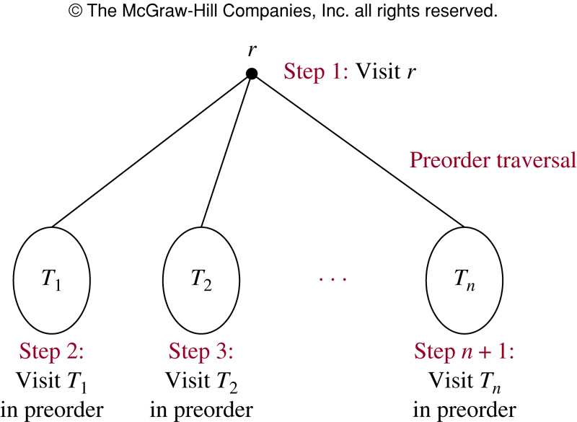
Preorder Traversal

Slide 32
Example
Tree:
Visiting sequence:
M
A
Y
E
J
R
H
P
Q
T
M
A
J
Y
R
H
P
Q
T
E

Slide 33
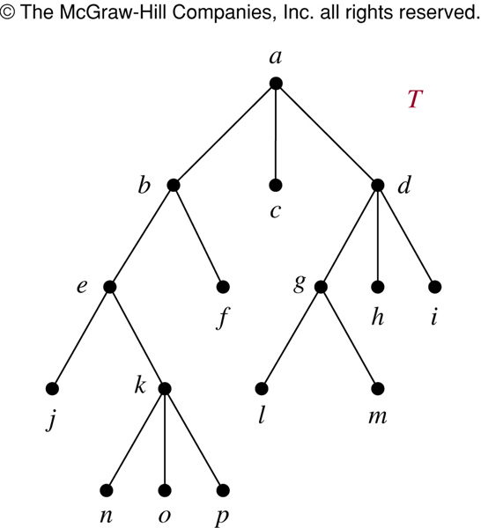
The Preorder Traversal of T
In which order does a preorder traversal visit the vertices in the ordered rooted tree T shown to the left?
Preorder:
Visit root, then visit subtrees left to right.

Slide 34
The Preorder Traversal of T
© The McGraw-Hill Companies, Inc. all rights reserved
Preorder:
Visit root, then visit subtrees left to right.

Slide 35
The Preorder Traversal of T
© The McGraw-Hill Companies, Inc. all rights reserved

Slide 36
The Preorder Traversal of T
© The McGraw-Hill Companies, Inc. all rights reserved

Slide 37
The Preorder Traversal of T
© The McGraw-Hill Companies, Inc. all rights reserved

Slide 38
Inorder Traversal
Step 1: Visit T₁ in inorder
Step 2: Visit r
Step 3: Visit T₂ in inorder
.
.
.
Step n+1: Visit T_{n} in inorder
r
T₁
T₂
T_{n}

Slide 39
Example
Tree:
Visiting sequence:
M
A
Y
E
J
R
H
P
Q
T
J
A
M
R
Y
P
H
Q
T
E

Slide 40
The Inorder Traversal of T
In which order does an inorder traversal visit the vertices in the ordered rooted tree T shown to the left?
Inorder:
Visit leftmost tree, visit root, visit other subtrees left to right.

Slide 41
The Inorder Traversal of T
© The McGraw-Hill Companies, Inc. all rights reserved
Inorder:
Visit leftmost tree, visit root, visit other subtrees left to right.

Slide 42
The Inorder Traversal of T
© The McGraw-Hill Companies, Inc. all rights reserved

Slide 43
The Inorder Traversal of T
© The McGraw-Hill Companies, Inc. all rights reserved

Slide 44
The Inorder Traversal of T
© The McGraw-Hill Companies, Inc. all rights reserved

Slide 45
Postorder Traversal
Step 1: Visit T₁ in postorder
Step 2: Visit T₂ in postorder
.
.
.
Step n: Visit T_{n} in postorder
Step n+1: Visit r
r
T₁
T₂
T_{n}

Slide 46
Example
Tree:
Visiting sequence:
M
A
Y
E
J
R
H
P
Q
T
J
A
R
P
Q
T
H
Y
E
M

Slide 47
The Postorder Traversal of T
In which order does a postorder traversal visit the vertices in the ordered rooted tree T shown to the left?
Postorder:
Visit subtrees left to right, then visit root.

Slide 48
The Postorder Traversal of T
© The McGraw-Hill Companies, Inc. all rights reserved
Postorder:
Visit subtrees left to right, then visit root.

Slide 49
The Postorder Traversal of T
© The McGraw-Hill Companies, Inc. all rights reserved

Slide 50
The Postorder Traversal of T
© The McGraw-Hill Companies, Inc. all rights reserved

Slide 51
The Postorder Traversal of T
© The McGraw-Hill Companies, Inc. all rights reserved

Slide 52
Representing Arithmetic Expressions
Complicated arithmetic expressions can be represented by an ordered rooted tree
Internal vertices represent operators
Leaves represent operands
Build the tree bottom-up
Construct smaller subtrees
Incorporate the smaller subtrees as part of larger subtrees

Slide 53
Example
(x+y)² + (x-3)/(y+2)
+
↑
/
+
2
–
+
x
y
x
3
y
2

Slide 54
Infix Notation
Traverse in inorder adding parentheses for each operation
+
↑
/
+
2
–
+
x
y
x
3
y
2
(
x
+
y
2
)
+
x
(
(
)
(
–
3
y
)
(
)
(
+
2
)
↑
/
)

Slide 55
Prefix Notation (Polish Notation)
Traverse in preorder:
+
↑
/
+
2
–
+
x
y
x
3
y
2
+
↑
+
x
y
2
/
–
x
3
+
y
2

Slide 56
Evaluating Prefix Notation
In an prefix expression, a binary operator precedes its two operands
The expression is evaluated right-left
Look for the first operator from the right
Evaluate the operator with the two operands immediately to its right

Slide 57
Example
+ / + 2 2 2 / – 3 2 + 1 0
+ / + 2 2 2 / – 3 2 1
+ / + 2 2 2 / 1 1
+ / + 2 2 2 1
+ / 4 2 1
+ 2 1
3

Slide 58
Postfix Notation (Reverse Polish)
Traverse in postorder
+
↑
/
+
2
–
+
x
y
x
3
y
2
x
y
+
2
↑
x
3
–
y
2
+
/
+

Slide 59
Evaluating Postfix Notation
In an postfix expression, a binary operator follows its two operands
The expression is evaluated left-right
Look for the first operator from the left
Evaluate the operator with the two operands immediately to its left

Slide 60
Example
2 2 + 2 / 3 2 – 1 0 + / +
4 2 / 3 2 – 1 0 + / +
2 3 2 – 1 0 + / +
2 1 1 0 + / +
2 1 1 / +
2 1 +
3

Slide 61
Conclusion
In this chapter we have studied:
Trees
Applications of Trees
Tree Traversal

